Slide 1
Limits
May 2011
Notes:
© 2006 Capgemini - All rights reserved
0

Slide 2
Navigation on Limits

Slide 3
Objective
At the end of this session, the participants will
Gain knowledge in Limit module navigation
Be able to Input Details in Limit Sub Menus
Understand the Mandatory fields and their descriptions
Be able to view the relevant enquiries and reports

Slide 4
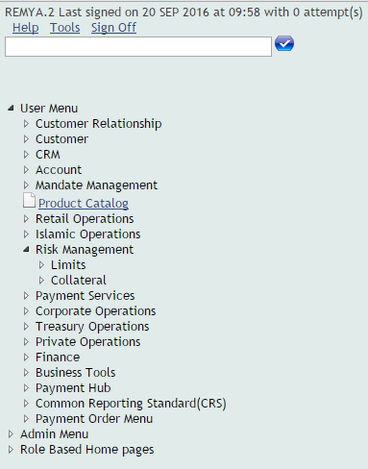
Accessing T24 Limits Application
Log on to T24 using T24 Sign In User Name and Password to view the User Menu.
Click on User Menu>Risk Management>Limits as shown in the screen below

Slide 5
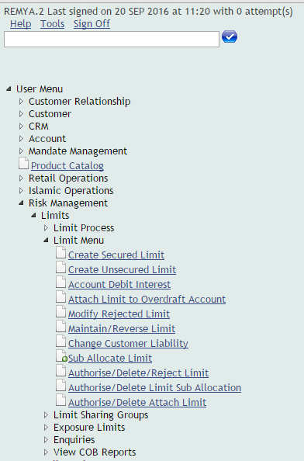
Accessing T24 Limits Application
Click on Limit Menu to be expanded the Sub Menus under it.
The relevant Sub Menus are displayed as shown in the screen below:

Slide 6
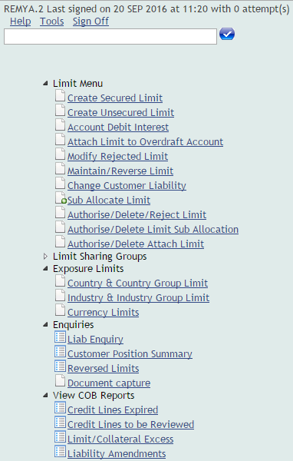
Menu Map – Limits
LIMITS

Slide 7
Limits - Mandatory Fields
Limit Currency - Defines limits by currency
Available Marker - Used to utilize the sanctioned limit
Collateral Code – Identifies the unique code for collateral
Limit Reference
Defines the type of limit
Global Limit
Example: 100189.1000.01
Product Limit
Example: 100189.1100.01
Sub product Limit
Example: 100189.1110.01

Slide 8
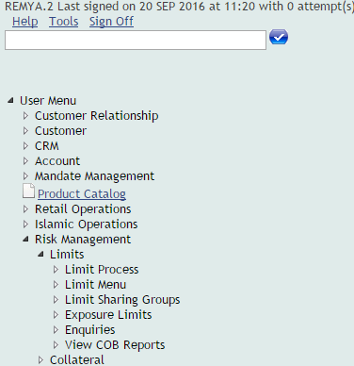
Limits And Its Menu
Click on “LIMITS” Option under Risk management, the relevant menu are displayed.
Limit Process
Limit Menu
Exposure Limits
Limit sharing Groups
Enquiries
View COB Reports

Slide 9
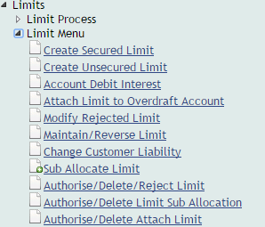
Limit Menu
LIMIT MENU>SUBMENU
Create Secured Limit
Create Unsecured Limit
Account Debit Interest
Attach Limit to Overdraft Account
Modify Rejected Limit
Maintain/Reverse Limit
Change Customer Liability
Sub Allocate Limit
Authorize/Delete/Reject Limit
Authorise/Delete Limit Sub Allocation
Authorise/Delete Attach Limit

Slide 10
Create Secured Limit
Secured Limit
If collateral code is attached to a limit, then it is called a secured Limit
Click on the sub menu, “Create Secured Limit” under Limit, Collateral Details Menu
A screen titled, “Secured Limit” will get displayed
Enter the ID
Id Format: Customer Number followed by Limit Reference followed by the sequence number
Ex: 100163.0001000.01
The Limit Reference (1000) is attached to a specific Category Code(s)
Notes:
Note: The LIMIT.REFERENCE is attached to the Category Codes available for the Products offered by the Bank. The ID will accept a valid Limit Reference attached to specific category codes depending upon the Products.

Slide 11
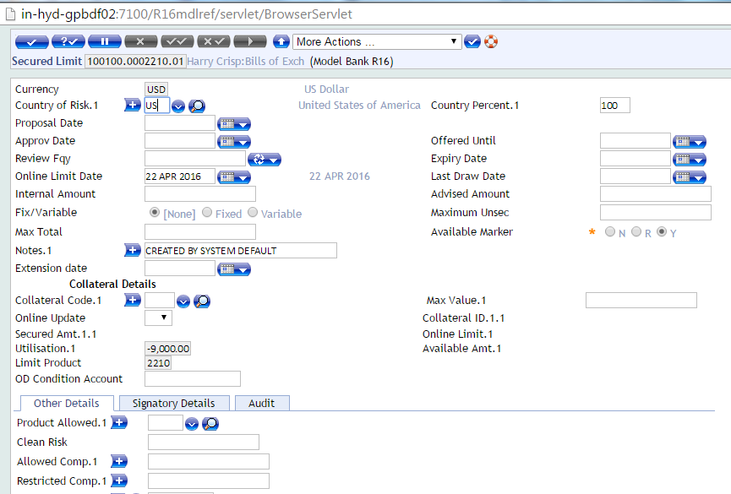
Create Secured Limit
Note the Available marker is defaulted to Y, for the credit limit to be facilitated to the Customer

Slide 12
Create Secured Limit
Mandatory Input fields include
Currency
Indicate the Currency in which Limit is granted
Internal Amount
Indicate Internal Amount of the Limit
Expiry Date
Denote the date on which the Credit Limit for the Product expires
Other Input fields include
Fixed/Variable
Input Fields under Collateral Details
Collateral Code.1
Available as a drop down list. The values are picked from COLLATERAL.CODE
Max Value.1
Denote the value of the Collateral
Both these fields are multi-value set

Slide 13
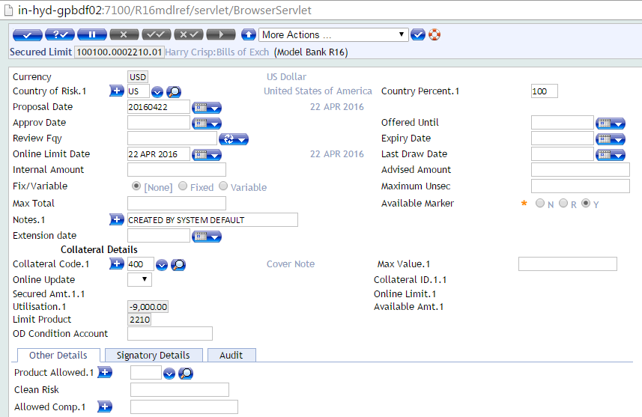
Create Secured Limit
After Input of the fields as indicated in the slide below click on icon “Validate a deal”

Slide 14
Screen showing Secured Limit before committing the deal

Slide 15
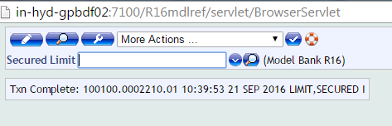
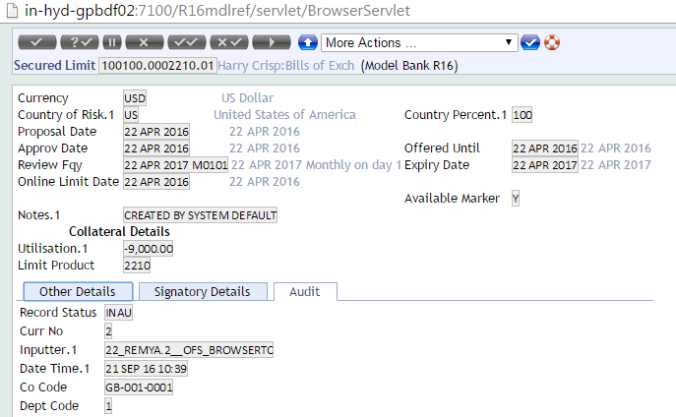
Screens showing Secured Limit after Committing

Slide 16
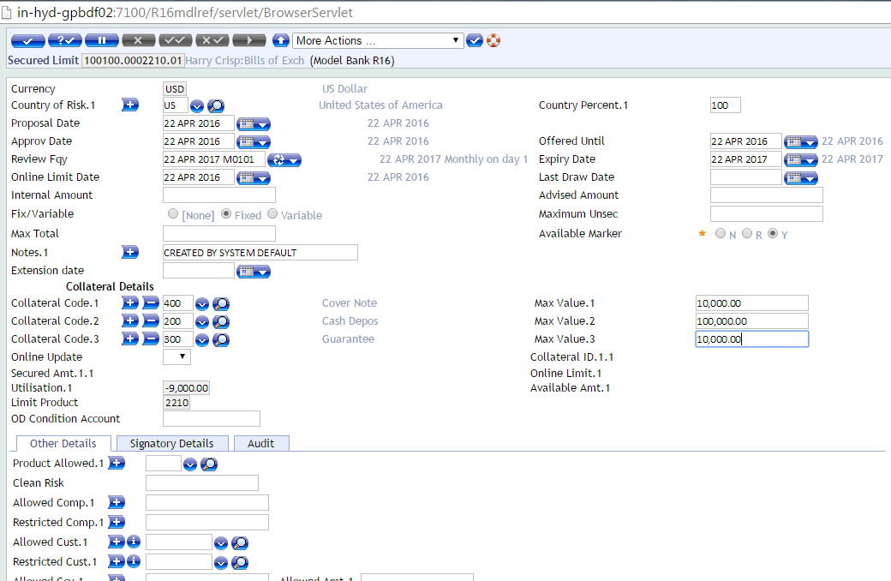
Screen showing Multiple Collateral attached to a Secured Limit
Multiple Collaterals can be attached to a Single Secured Limit

Slide 17
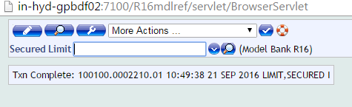
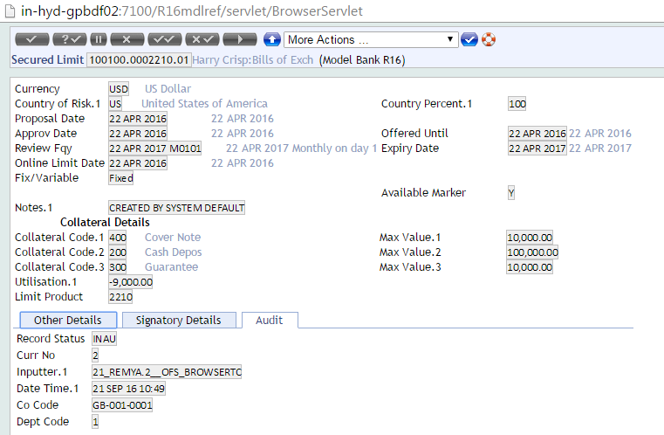
Screen showing Multiple Collateral attached to a Secured Limit after committing

Slide 18
Create Unsecured Limit
Unsecured Limit
If collateral code is not attached to a limit, then it is called as an unsecured Limit
Click on the sub menu, “Create Unsecured Limit” under Limit Menu
A screen titled, “Unsecured Limit” will get displayed
Enter the ID
Id Format: Customer Number followed by Limit Reference followed by the sequence number
Ex: 100163.1600.01

Slide 19
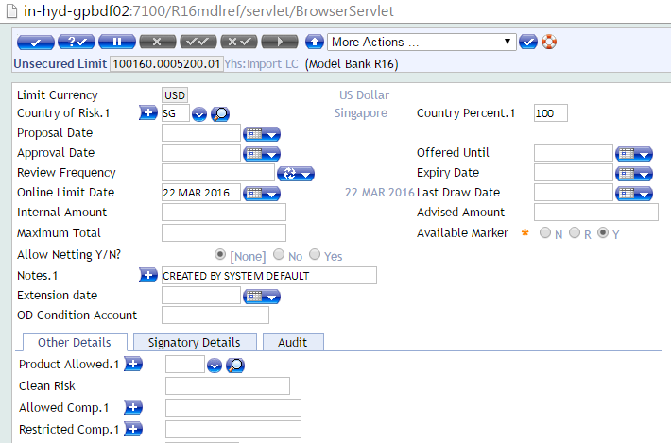
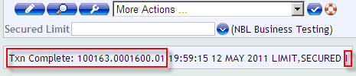
Create Unsecured Limit
Note the Available marker should be set to Y, for the credit limit to be facilitated to the Customer

Slide 20
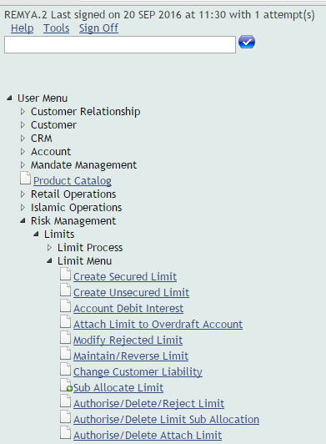
Account Debit Interest
Use Limits> Limit Menu> Account Debit Interest as shown in the screen below

Slide 21
Account Debit Interest
Used to define special Debit Interest conditions for individual Account when the Group Debit Interest specifications are not suitable
Click on “Account Debit Interest”
A relevant screen titled “Account Debit Interest” is displayed
Enter the Account Number and press Enter
Example: 1001000000540

Slide 22
Account Debit Interest
Note the Date in DD/MM/YYY format gets appended at the end of the Account Number
ID: Account Number – Date
Where:
1001000000540 – Account Number
06 APR 2011 – Date on which the Debit Interest conditions are set for the Account
The screen in the next slide shows the Input details for Account Debit Interest Application

Slide 23
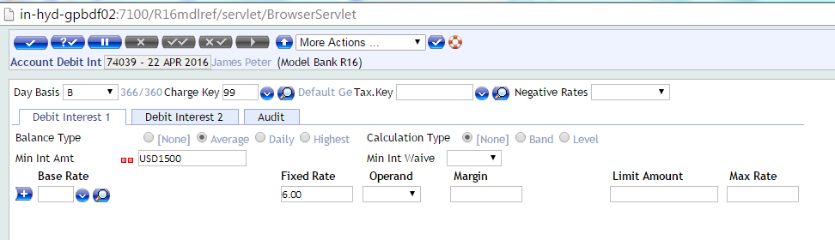
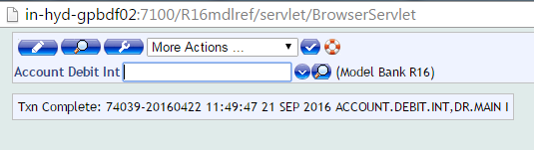
Account Debit Interest
The field Day Basis is used to determine the number of days used for Debit Interest Calculation

Slide 24
Account Debit Interest
The Day Basis field is an Optional Input field
If left blank, the system defaults option B
If NONE or GENERAL is entered, all Fields after this must be blank.
The field Charge Key holds the ID of the General Charge Record
Here ID 99 is used as default.

Slide 25
Account Debit Interest
Balance Type field identifies the Balance on which interest calculations are to be performed
Options available:
Average
Daily
Highest
Input to this field is restricted, when the Interest Day Basis field contains the value NONE or GENERAL
Otherwise a mandatory input field

Slide 26
Account Debit Interest
Calculation Type field determines the type of Calculation to be performed on the Debit Balance
Options available are:
None
Band
Level
No input to this field, when the Interest Day Basis has the value NONE or GENERAL

Slide 27
Attach Limit To Overdraft Account
Used to attach a limit to overdraft account
Click on “Attach Limit To Overdraft Account”
A relevant screen is displayed to enter Overdraft Account (Current Account) number. Where the ID is:
ACCOUNT NUMBER
Example: 1001000001929
Press enter to navigate into its respective screen
Limit Reference Number is a mandatory field to be input
Limit Reference Number followed by the Serial Number of the Limit sanctioned
Ex:100.1 where
100 - Limit Reference
1 - Serial Number of the limit.

Slide 28
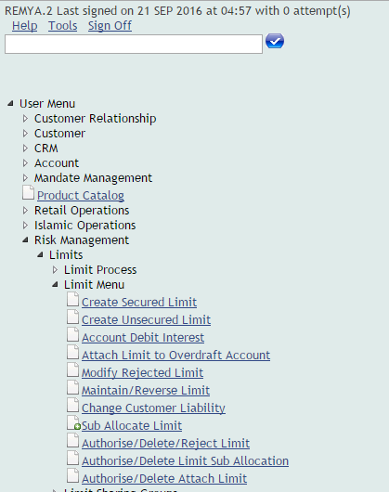
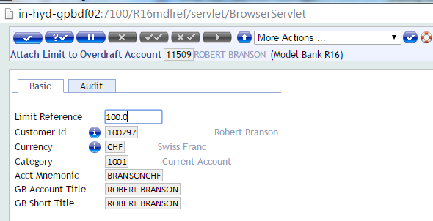
Attach Limit To Overdraft Account

Slide 29

Maintain/Reverse Limit
This submenu enables the function of reversal and amendment of limits
Click on “Maintain/Reverse Limit”, an Application is displayed titled “Maintain/Reverse Limit”
List of Limit ID’s are displayed with its respective details giving options to “Amend” and “Reverse”

Slide 30
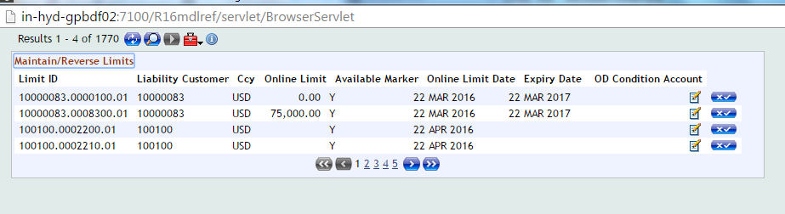
Maintain/Reverse Limit
Amend Limit -
This button enables the function to Amend the Limit Record of a Customer
Reverse Limit –
This button enables the function to Reverse the Limit Record
Upon clicking “Amend/Reverse” icon, Maintain Limit Application will be displayed

Slide 31
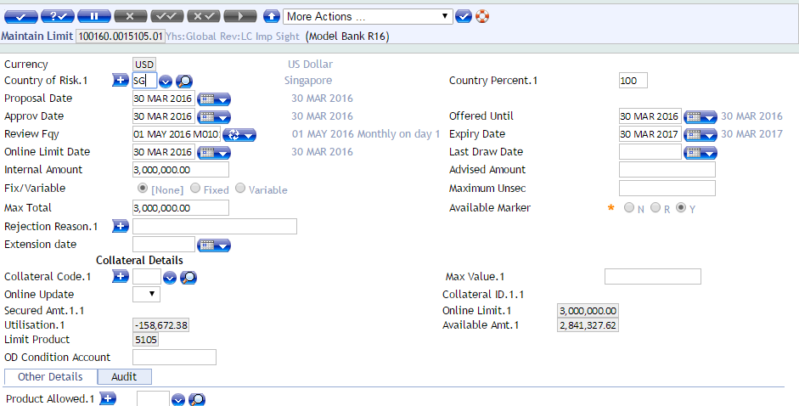
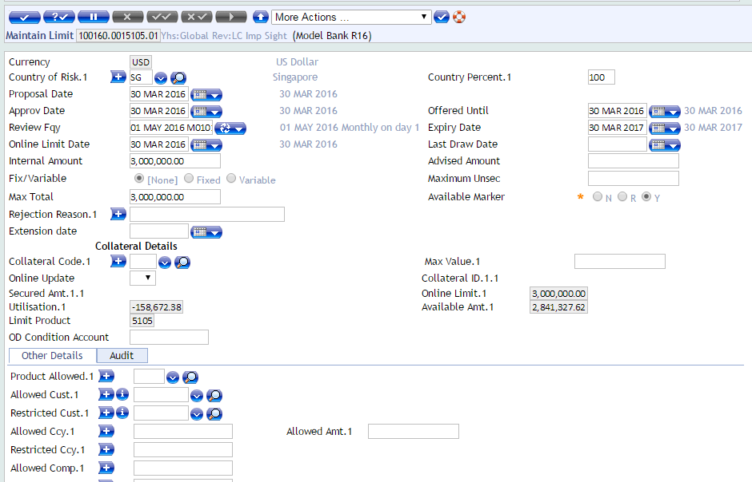
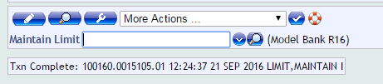
Maintain Limit
Button Functions
Amend Limit
Existing limit details can be altered
Reverse Limit
Removes the Limit records from live file

Slide 32


Maintain Limit
At the instance of Reversal, the Record Status shows as given below
Once the Reversed Record is Authorized, the Record Status changes to REVE

Slide 33
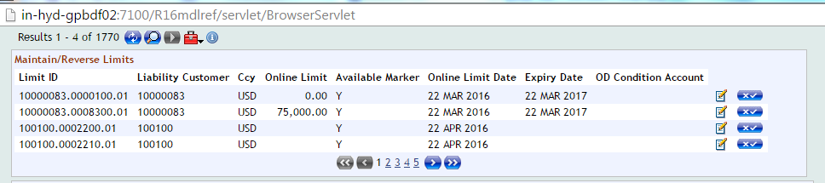
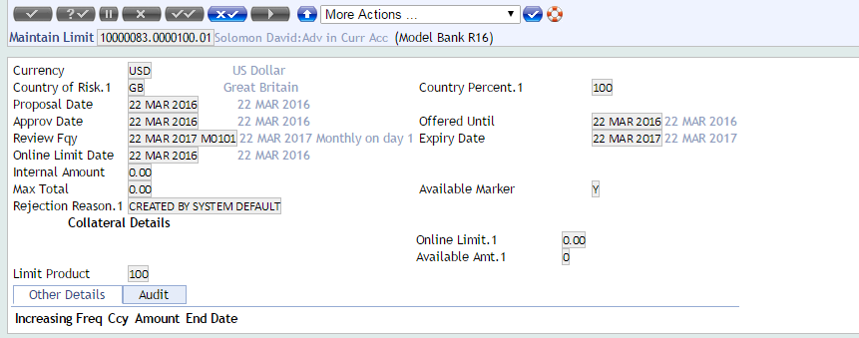
Maintain Limit
Note: When a Transaction is attached to a Limit, the Limit Record cannot be Reversed. Not all the Limit records can be reversed

Slide 34
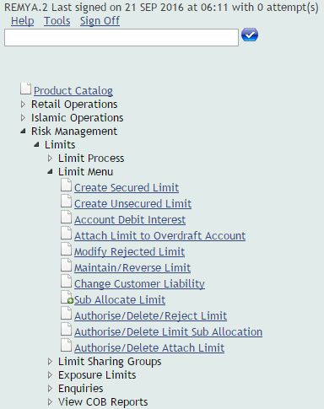
Change Customer Liability
This submenu helps to change the customer liability in customer record.
While running COB, the changes done in the customer liability is reflected in the customer record.

Slide 35
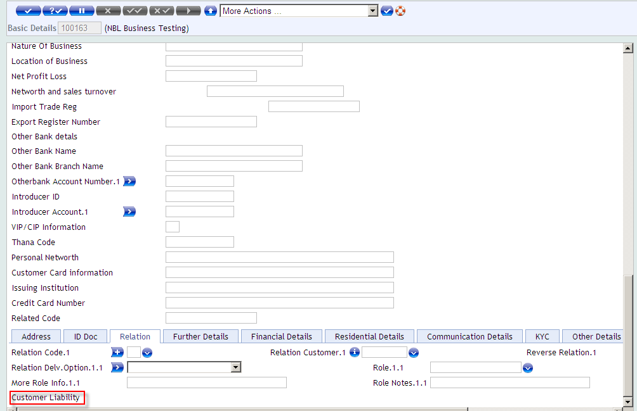
Change Customer Liability
Customer Record before the Change in Liability
Customer Liability field is Null

Slide 36
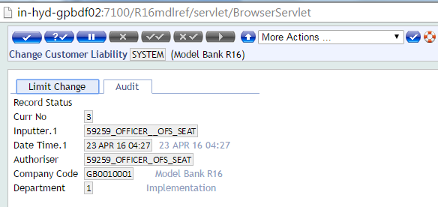
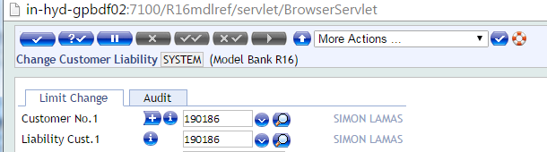
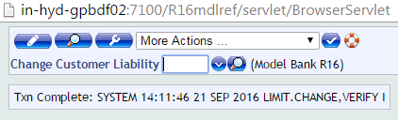
Change Customer Liability
In the Change Customer Liability only one record called, “SYSTEM” exists
Enter the Customer No
Liability Customer No as shown here
Authorize the Record

Slide 37
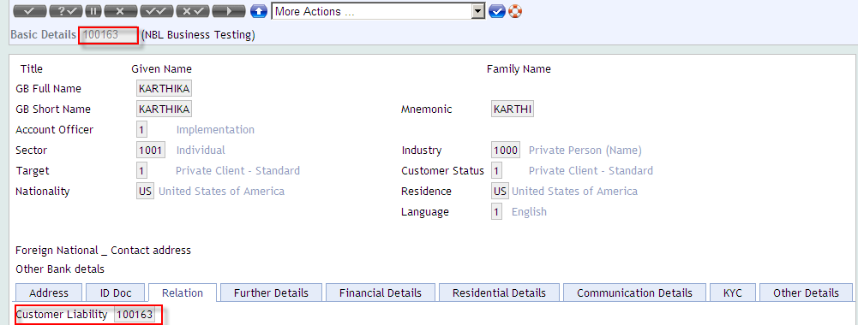
Change Customer Liability
Customer Liability changed/updated after COB Process

Slide 38
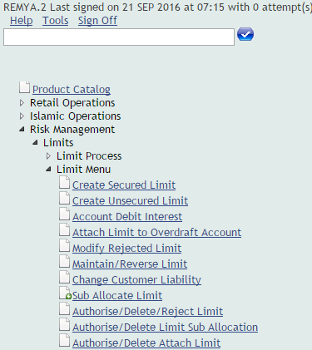
Sub Allocate Limit
This submenu enables recording all the sub allocations within the Limit system
Click on “Sub Allocate Limit ”, an Application is displayed titled “Limit Sub Allocation”

Slide 39
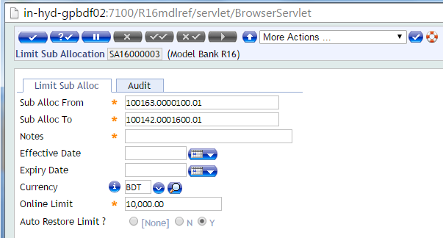
Sub Allocate Limit
Enter the mandatory fields and save the record

Slide 40

Authorise/Delete Limit
Using this submenu, the limit details (which are Created, Maintained and Reversed) can be authorized/Deleted
Click on “Authorise/Delete Limit ”, a form is displayed with its respective details and an option to “Authorize” and “Delete” limits
Authorize Limit –
This button enables the function of authorization.
Delete Limit -
This button enables the function of deletion.

Slide 41
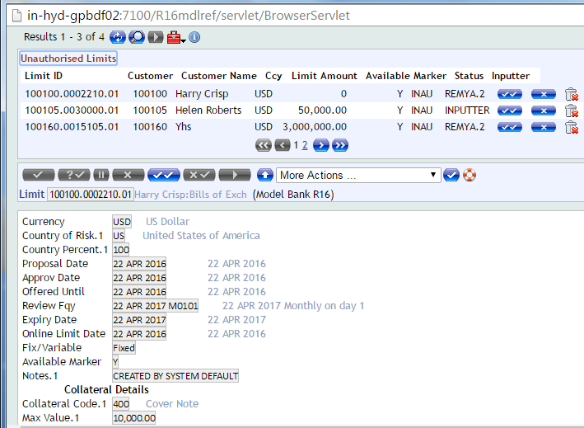
Authorize Limit

Slide 42
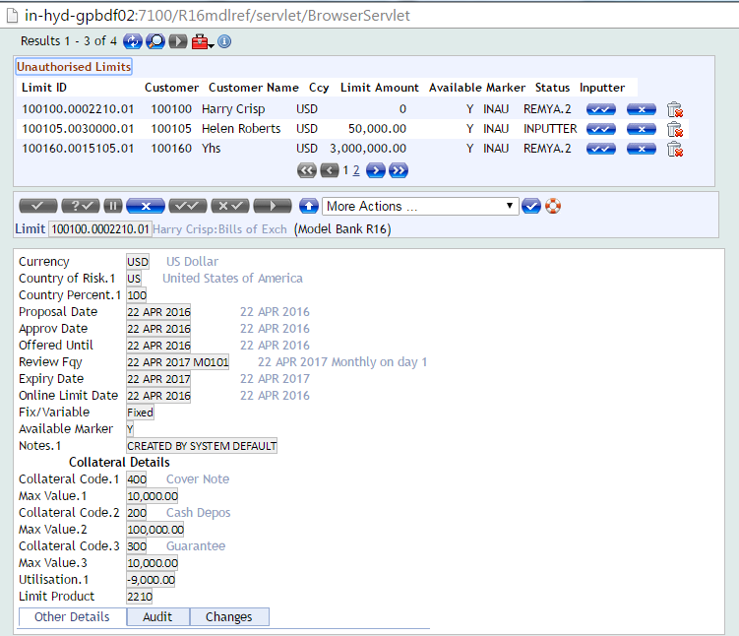
Delete Limit

Slide 43
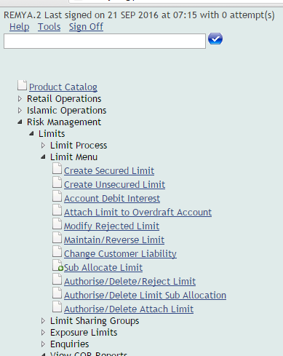
Authorise/Delete Limit Sub Allocation
Click on “Authorise/Delete Limit Sub Allocation”, an Unauthorised Limit Sub Allocation Records screen appears as shown below

Slide 44
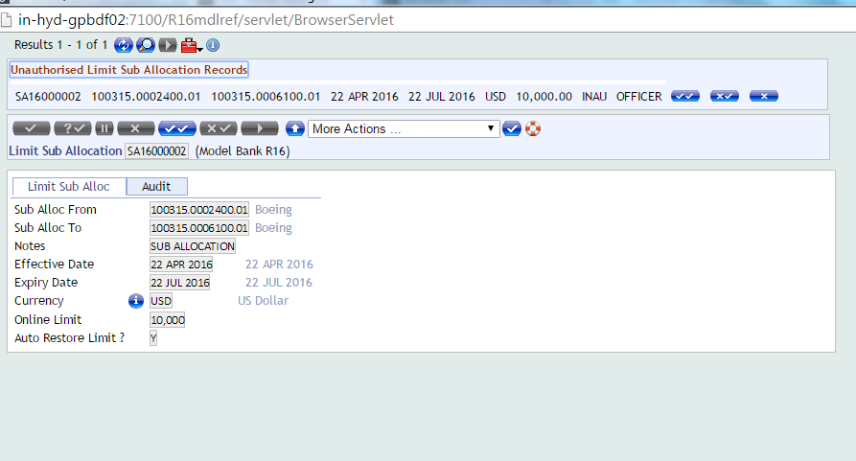
Authorise Limit Sub Allocation

Slide 45
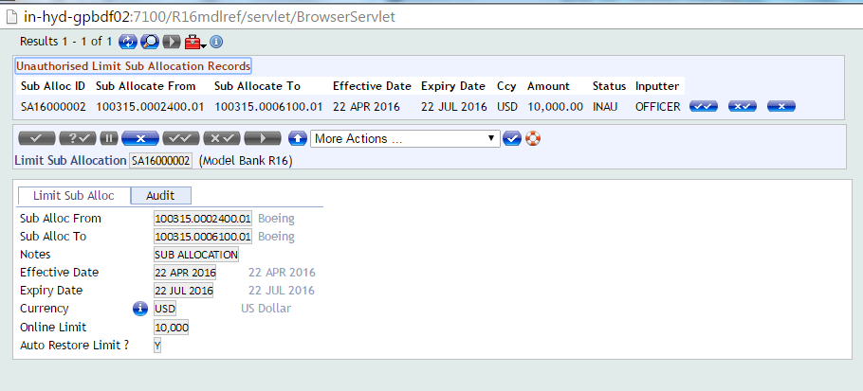
Delete Limit Sub Allocation

Slide 46
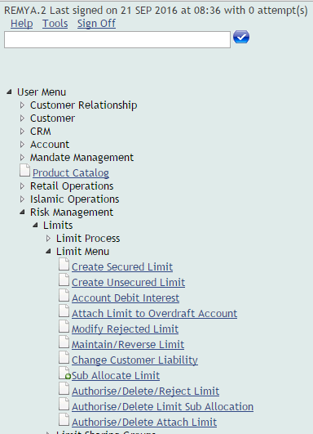
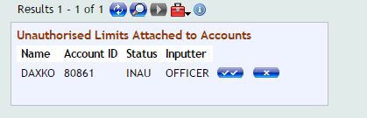
Authorise/Delete Attach Limit
This menu is used to Authorize/Delete Limits attached to Overdraft Account
Click on the Menu “Authorise/Delete Attach Limit”
The system Lists the details of Unauthorised Limits attached to the Overdraft Account as displayed in the screen below:

Slide 47
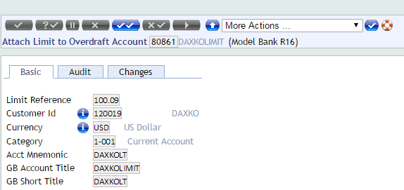
Authorise Attach Limit
Use icons:
To Authorise –
To Delete –

Slide 48
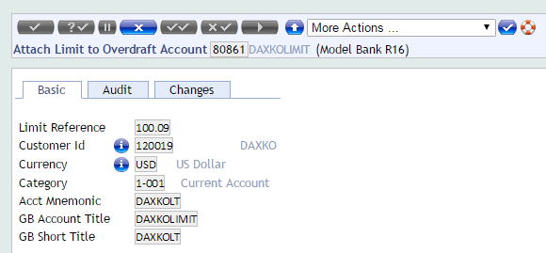
Delete Attach Limit
The screen below shows the action to delete the Overdraft Limit Record
Delete the record

Slide 49
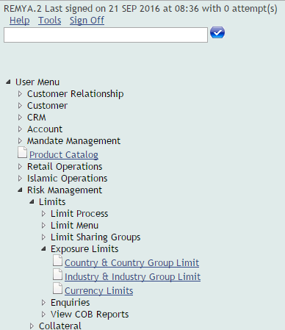
Group Limits
EXPOSURE LIMITS>SUBMENUS
Country & Country Group Limit
Industry & Industry Group Limit
Currency Limits
A system default limit is set for all these groups.

Slide 50
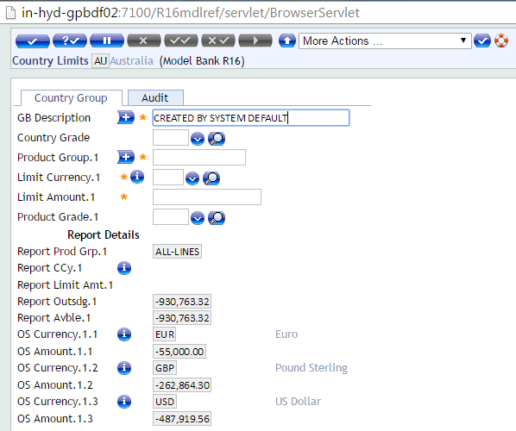
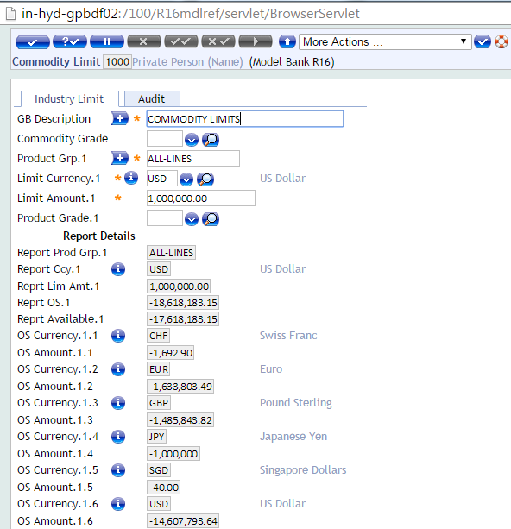
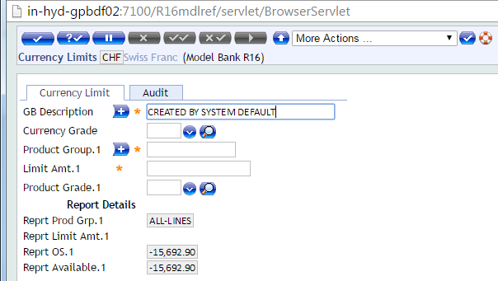
Default Input Fields For All Group Limits

Slide 51
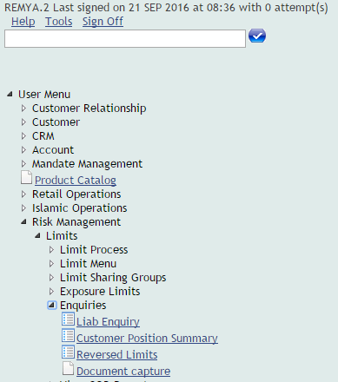
Enquiries
ENQUIRIES>SUBMENUS
Liab Enquiry
Customer Position Summary
Reversed Limits

Slide 52
Enquiry – Liab Enquiry
Using this menu, Limit summary/Customer Liability can be enquired
On clicking this menu, a form is displayed with the respective fields to enter the desired keyword in the criteria textbox
Click on “Find” icon, to view customer position summary details
Based on the desired keyword entry, the result page is displayed.

Slide 53
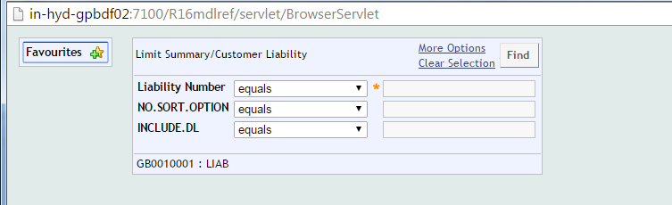
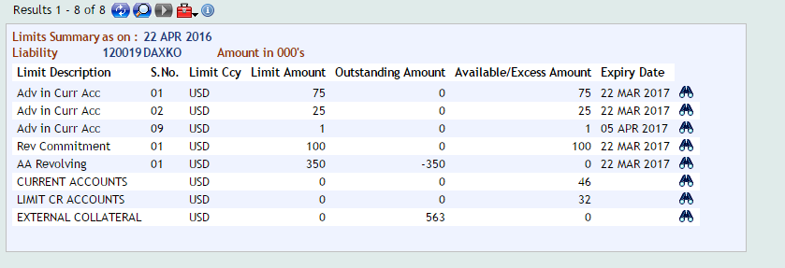
Liab Enquiry

Slide 54
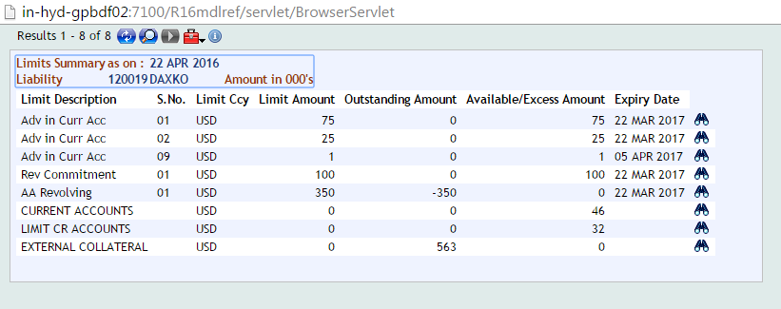


Liab Enquiry

Slide 55

Liab Enquiry

Slide 56
Enquiry - Customer Position Summary
Using this menu, Customer position summary can be enquired
On clicking this menu, a form is displayed with the respective fields to enter the desired keyword in the criteria textbox
Click on “Find” icon, to view customer position summary details
Based on the desired keyword entry, the result page is displayed

Slide 57


Customer Position Summary
s

Slide 58

Customer Position Summary

Slide 59

Customer Position Summary

Slide 60

Enquiry – Reversed Limits
This Menu Lists Limit Reversal Records
On clicking this menu, the system displays the Details of Limit Reversal Records as displayed in the screen below:
Click on to drill down to the Reversed Transaction Application as shown in the next slide

Slide 61

Enquiry – Reversed Limits

Slide 62

View COB Reports
VIEW COB REPORTS>SUBMENUS
Credit Lines Expired
Credit Lines to be Reviewed
Limit/Collateral Excess
Liability Amendments

Slide 63

Credit Line Expired
Shows credit lines expired report.
Details of expired Limits

Slide 64

Credit Line Expired

Slide 65


Credit Lines to be Reviewed
Shows credit lines to be Reviewed
Details of reviewed Limits

Slide 66

Liability Amendments
Displays the Limits - Liability Amendment Records

Slide 67
Summary
At the end of the session the participants will be able to:
Create secured Limit
Create unsecured Limit
Create Account Debit Interest
Attach Limit to Overdraft Account
Maintain and Reverse a Limit
Change the Customer Liability
View COB Reports
Use Enquiries related to Limits

Slide 68


www.capgemini.com/financialservices

